Slide 1
Welcome To My presentation

Slide 2
Presentation to
Md. Imran Hossain
Assistant Professor
Department Of ICT
Comilla University
Presentation By
Sajib Sarkar
ID: 11809044
ICT Department
Comilla University

Slide 3
Analog Communication
AM Receiver

Slide 4
What is AM Receiver?
An AM receiver detects amplitude fluctuations in the radio waves at a specific frequency.
What are the characteristics of AM receiver?
Selectively
Fidelity
Sensitivity
Double spotting

Slide 5
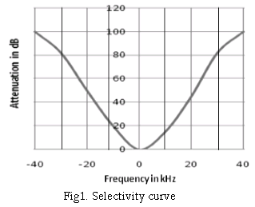
Selectively
The selectivity of an AM receiver is defined as its ability to accept or select the desired band of frequency and reject all other unwanted frequencies which can be interfering signals.
Adjacent channel rejection of the receiver can be obtained from the selectivity parameter.
Response of IF section, mixer and RF section considerably contribute towards selectivity.
The signal bandwidth should be narrow for better selectivity.

Slide 6
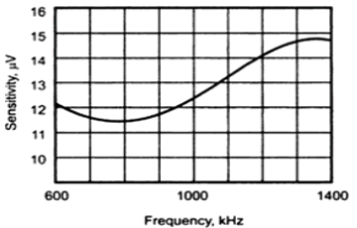
Sensitivity
Sensitivity is also known as receiver threshold.
It is expressed in microvolts or decibels.
Sensitivity of the receiver mostly depends on the gain of IF amplifier.
It can be improved by reducing the noise level and bandwidth of the receiver.

Slide 7
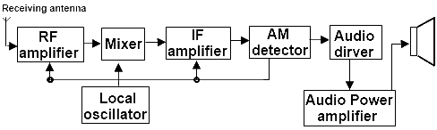
AM Receiver
Block Diagram

Slide 8
Thanks

